Slide 1


School of Computing and Information Technology, Eastern International University (EIU) - Vietnam

Slide 2
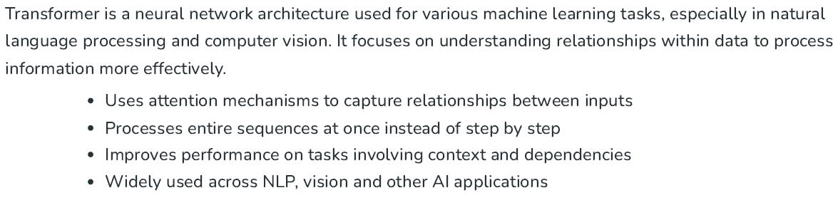
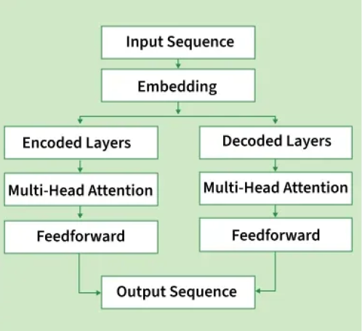
School of Computing and Information Technology, Eastern International University (EIU) - Vietnam

Slide 3
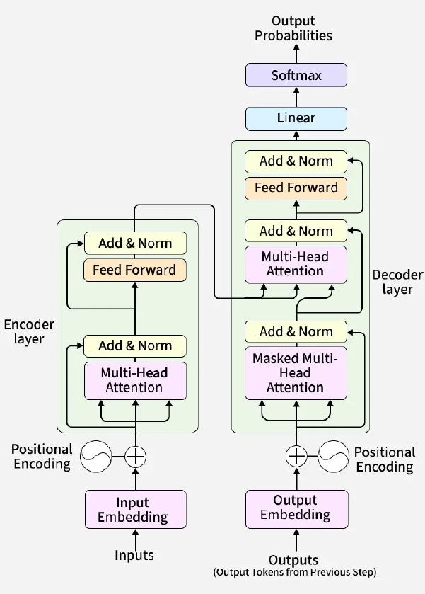
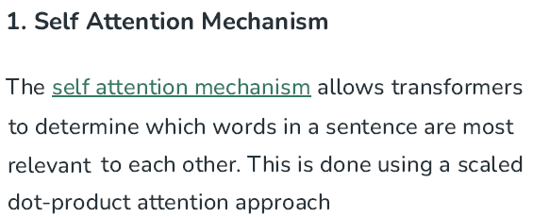
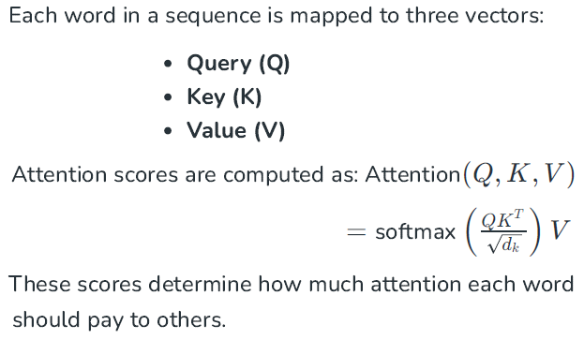

Slide 4
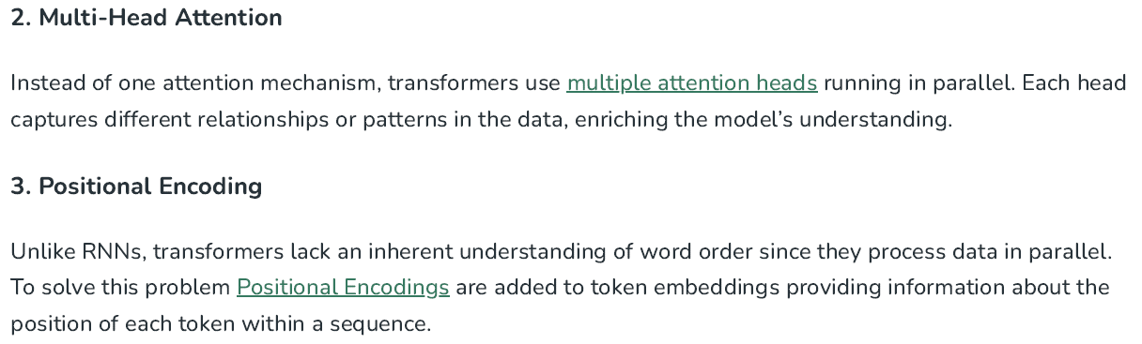
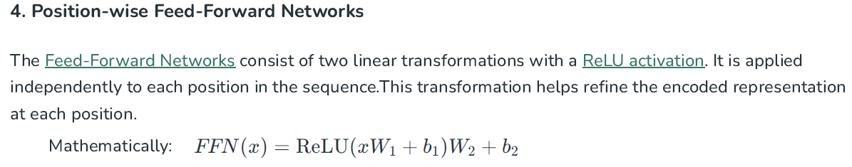

Slide 5
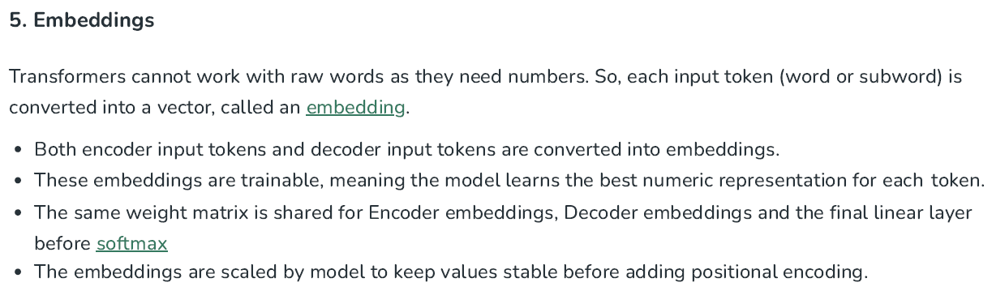
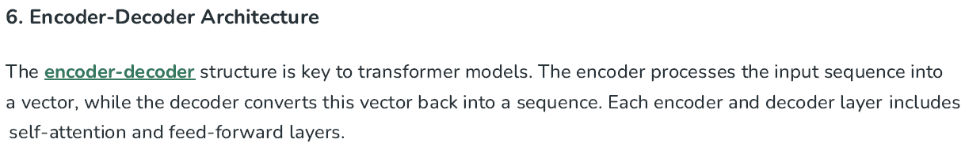
School of Computing and Information Technology, Eastern International University (EIU) - Vietnam

Slide 6
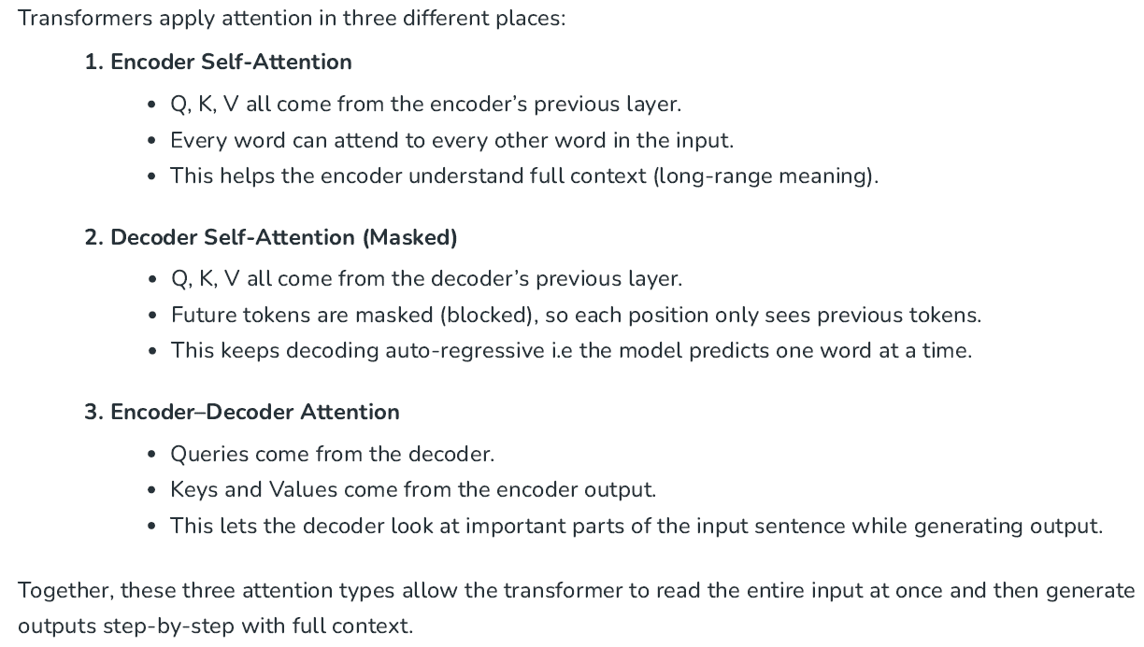

Slide 7
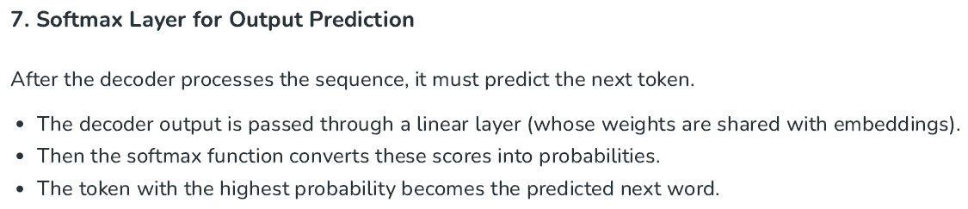

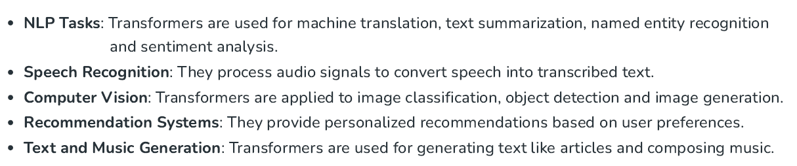
School of Computing and Information Technology, Eastern International University (EIU) - Vietnam

Slide 8

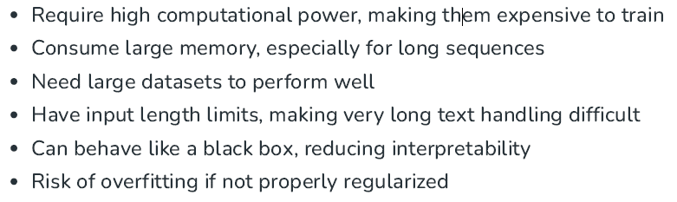
School of Computing and Information Technology, Eastern International University (EIU) - Vietnam

